Slide 1
Nitrogen Problem
Excessive nitrogen (N) from a variety of sources has led to decreases in the environmental quality of coastal rivers, ponds, and harbors in many communities in southeastern Massachusetts.*
In the coastal waters of Massachusetts the problems include:
Loss of eelgrass beds, which are critical habitats for aquatic life
Periodic extreme decreases in dissolved oxygen concentrations that threaten aquatic life
Reductions in the diversity of animal populations
Periodic algae blooms
*Source: Nantucket Harbor Embayment System Total Maximum Daily Loads For Total Nitrogen Report # 97-TMDL-2

Slide 2
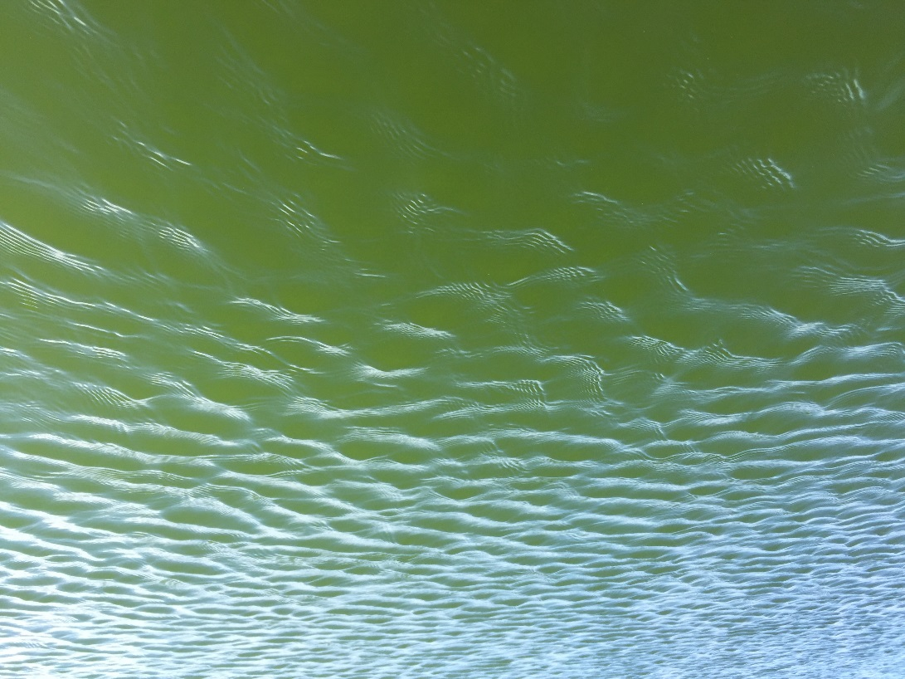
These are actual algae blooms in Hummock Pond

Slide 3
Nitrogen Background
Nitrogen in the form of Nitrates, Nitrites, and Ammonium are a byproduct of digestion, and chemical processes.
These, in the presence of water, can provide nutrients to algae and other toxic organisms that hurt water quality.
The sources of N from the watershed include:
Septic systems
Runoff
Fertilizers
Natural background

Slide 4
Nantucket Harbor Nitrogen
*Source: Nantucket Harbor Embayment System Total Maximum Daily Loads For Total Nitrogen Report # 97-TMDL-2

Slide 5
Total Nitrogen Load
149.51 kg of nitrogen per day is dumped into the Nantucket Harbor System from all sources
~14.95 kg of that nitrogen is from Wastewater, Fertilizer, and other Runoff
Measured as Total Maximum Daily Load (TMDL)

Slide 6
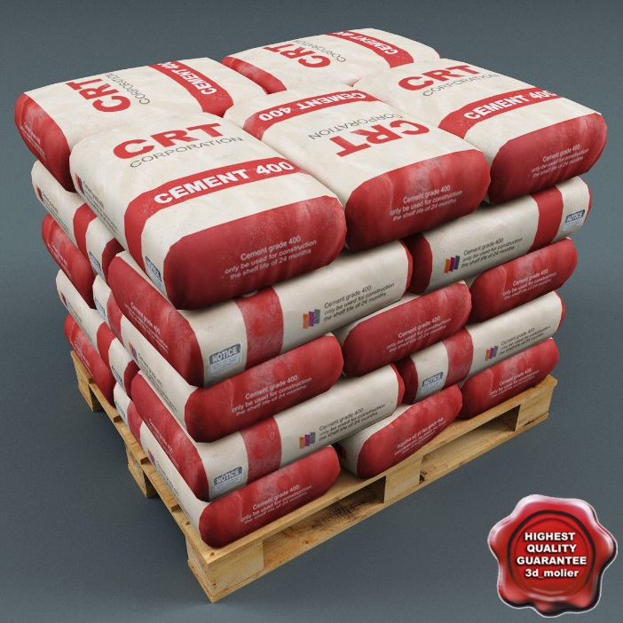
That’s the equivalent to about a bag of concrete every other day.
Or about 3 pallets of concrete poured down the drain per year!

Slide 7
So, what can we do?
Lower the concentrations of N by reducing the loadings from on-site subsurface wastewater disposal (septic) systems, runoff, and fertilizers.
Multiple strategies, proposed by Nantucket to reduce these N Loadings:
Innovative/Alternative (I/A) Septic Systems
Increased fertilizer management
Sewering
Storm water controls

Slide 8
Septic System Overview
Sewer Line
Septic Tank
Distribution Box
Drain Field

Slide 9
Septic Tank
Make sure that the tank is not installed backwards!

Slide 10
Board of Health Wastewater Regulations

Slide 11
Regulations Overview
All systems within a watershed are restricted to 110 gallons per day of effluent flow for every 10,000 square feet of land with no bedroom credits allowed (4 bedrooms per acre maximum)
Watersheds:
Nantucket Harbor
Hummock Pond
Madaket Harbor
All failed systems within a watershed must upgrade to an Innovative/Alternative system as defined by Title 5 (310 CMR 15.00)
All systems within a sewer district must connect to sewer within an allotted timeframe (6 or 24 months depending on system location)

Slide 12
Why Innovative/Alternative?
All approved I/A systems reduce the amount of Nitrogen in the effluent by at least 50%
Coupled with flow restrictions, the denitrification can provide a minimum of 66% denitrification of effluent flow
I/A systems require operation and maintenance agreements that ensure proper function; resulting in less burden on town services

Slide 13
Fertilizer Management
Board of Health Regulation 75.00 “Fertilizer Regulations”
Requires that all professional fertilizer application be performed by a licensed applicator.
Each applicator must go through a fertilizer class and follow the “Fertilizer Best Management Practices”

Slide 14
Fertilizer Licensing Class Schedule
March 17, 2015 - 9AM Dreamland Theater - Core Best Management Practices
April 17, 2015 - 9AM Training Room Public Safety Facility
April 24, 2015 - 9AM Community Room Public Safety Facility
May 1st, 2015 - 9AM Community Room Public Safety Facility

Slide 15
Fertilizer Class Agenda
Background
Soil types
Soil Testing
Calculations (area, dilutions, Maximum use)
Best Management practices

Slide 16
Fertilizer License
Must be carried by all fertilizer applicants at all times.

Slide 17
Expected improvements
Over the course of the next year:
Reduced nitrogen and phosphorous runoff and leach into the watershed areas
Reduced TMDL numbers
Nitrogen release from sediments
Reduced algae blooms
Safe water

Slide 18
More Information

Slide 19
Nantucket Health Department
3 East Chestnut St (NRTA building) Nantucket, MA 02554 Phone: 508-228-7200
Fax: 508-325-6117 Hours: Monday - Friday 7:30 a.m. - 4:00 p.m.

